Slide 1
CHAPTER three
CPU SCHEDULING

Slide 2
Chapter Objectives:
To introduce CPU scheduling, which is the basis for multi-programmed operating systems.
To discuss evaluation criteria for selecting a CPU-scheduling algorithm for a particular system.
To describe various CPU-scheduling algorithms.

Slide 3
Basic Concepts
In a single-processor system, only one process can run at a time; any others must wait until the CPU is free and can be rescheduled.
The objective of multiprogramming is to have some process running at all times, to maximize CPU utilization.
Scheduling is a fundamental operating-system function.
Almost all computer resources are scheduled before use.
The CPU is, of course, one of the primary computer resources.
Thus, its scheduling is central to operating-system design.

Slide 4
Process scheduling
Introduction:
Scheduling refers to the set of policies and mechanisms that an OS supports for determining the order of execution of the pending jobs and processes.
The process scheduling is the activity of the process manager that handles the removal of the running process from the CPU and the selection of another process on the basis of a particular strategy.
A scheduler is an OS program that selects the next job to be admitted for execution.
The main objective of scheduling is to increase CPU utilization and to increase the throughput.
Throughput: means the amount of work accomplished in a given time interval.

Slide 5
CPU Scheduler
Selects from among the processes in memory that are ready to execute and allocates the CPU to one of them.
CPU scheduling decisions may take place when a process:
Switches from running to waiting state (ex., I/O request).
Switches from running to ready state (ex., Interrupts occur).
Switches from waiting to ready (ex., Completion of I/O).
Terminates.
Scheduling under 1 and 4 is non-preemptive(till it terminates or switches to waiting state); otherwise is called preemptive (limited time).

Slide 6
CPU Scheduler
CPU scheduling is a process that allows one process to use the CPU while the execution of another process is on hold(in waiting state) due to unavailability of any resource like I/O etc., thereby making full use of CPU.
The aim of CPU scheduling is to make the system efficient, fast, and fair.
In preemptive scheduling the CPU is allocated to the processes for the limited time whereas in Non-preemptive scheduling, the CPU is allocated to the process till it terminates or switches to waiting state.

Slide 7
Preemptive Scheduling:
Preemptive scheduling is used when a process switches from running state to ready state or from waiting state to ready state.
The resources (mainly CPU cycles) are allocated to the process for the limited amount of time and then is taken away, and the process is again placed back in the ready queue if that process still has CPU burst time remaining.
That process stays in ready queue till it gets next chance to execute.
Algorithms based on preemptive scheduling are: Round Robin (RR),Shortest Remaining Time First (SRTF), Priority (preemptive version), etc.

Slide 8
Non-Preemptive Scheduling:
Non-preemptive Scheduling is used when a process terminates, or a process switches from running to waiting state.
In this scheduling, once the resources (CPU cycles) is allocated to a process, the process holds the CPU till it gets terminated or it reaches a waiting state.
In case of non-preemptive scheduling does not interrupt a process running CPU in middle of the execution.
Instead, it waits till the process complete its CPU burst time and then it can allocate the CPU to another process.
Algorithms based on non-preemptive scheduling are: Shortest Job First (SJF basically non preemptive) and Priority (non preemptive version), etc.

Slide 9
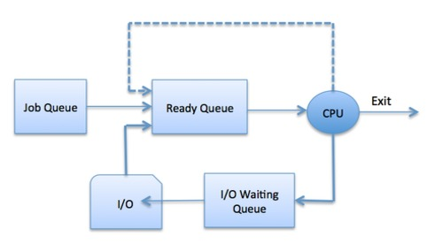
Process Scheduling Queues revision
Job queue − This queue keeps all the processes in the system.
Ready queue − This queue keeps a set of all processes residing in main memory, ready and waiting to execute. A new process is always put in this queue.
Device queues − The processes which are blocked due to unavailability of an I/O device constitute this queue.

Slide 10
Types of scheduler
Schedulers are special system software which handle process scheduling in various ways.
Their main task is to select the jobs to be submitted into the system and to decide which process to run.
Schedulers are of three types −
Long term scheduler
Medium term scheduler
Short term scheduler

Slide 11
Long-Term scheduler
Due to the smaller size of main memory initially all program are stored in secondary memory.
When they are stored or loaded in the main memory they are called process.
This is the decision of long term scheduler that how many processes will stay in the ready queue.
Hence, in simple words, long term scheduler decides the degree of multi-programming of system.
It also known as a job scheduler
“ Long-term ” scheduler b/c the time for which the scheduling is valid is long.

Slide 12
Long-Term scheduler
When the processor utilization is low then the scheduler admits more jobs to increase the number of processes in the ready queue.
Similarly when the utilization factor is very high then the long-term scheduler may reduce the rate of batch jobs.
Long-term scheduler is invoked very infrequently (seconds, minutes) ⇒ (may be slow).
Selects which processes should be brought into the ready queue.

Slide 13
Medium Term Scheduler
Most often, a running process needs I/O operation which doesn’t requires CPU.
Hence during the execution of a process when an I/O operation is required then the operating system sends that process from running queue to blocked queue.
When a process completes its I/O operation then it should again be shifted to ready queue.
Or in other word, A running process may become suspended if it makes an I/O request.
In this condition, to remove the process from memory and make space for other processes, the suspended process is moved to the secondary storage.
All these decisions are taken by the medium-term scheduler. Medium-term scheduling is a part of swapping. Or This process is called swapping

Slide 14
Short-Term scheduler
Short-Term scheduler(CPU scheduler) selects a process among the processes that are ready to execute and allocates CPU to one of them.
It is the change of ready state to running state of the process.
Its main objective is to maximize CPU utilization and to increase system performance in accordance with the chosen set of criteria.
Short-term scheduler is invoked very frequently (milliseconds) ⇒ (must be fast).
Selects which process should be executed next and allocates CPU.
Short-term scheduler executes at least once every 10 milliseconds.
Short-term schedulers, also known as dispatchers, make the decision of which process to execute next.

Slide 15
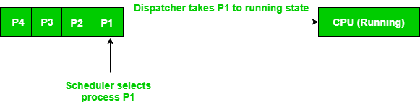
Dispatcher
A Dispatcher is a special program which comes into play after the scheduler.
When the scheduler completes its job of selecting a process, it is the dispatcher which takes that process to the desired state/queue.
The dispatcher is the module that gives a process control over the CPU after it has been selected by the short-term scheduler.
Difference between Dispatcher and Scheduler

Slide 16
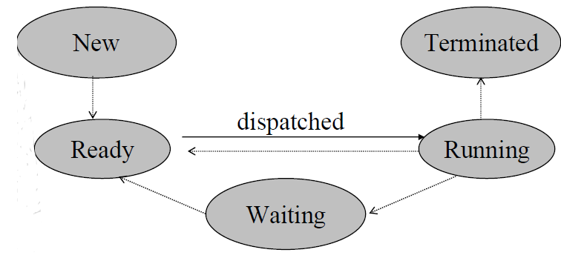
Difference between dispatcher and scheduler
Df

Slide 17
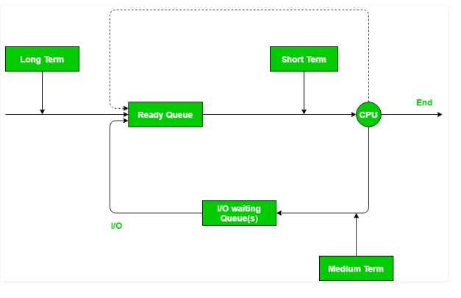
Schedulers with diagram
Df

Slide 18
Comparison among Scheduler
.
S.N | Long-Term Scheduler | Short-Term Scheduler | Medium-Term Scheduler
1 | It is a job scheduler | It is a CPU scheduler | It is a process swapping scheduler.
2 | Speed is lesser than short term scheduler | Speed is fastest among other two | Speed is in between both short and long term scheduler.
3 | It controls the degree of multiprogramming | It provides lesser control over degree of multiprogramming | It reduces the degree of multiprogramming.
4 | It is almost absent or minimal in time sharing system. | It is also minimal in time sharing system. | It is a part of Time sharing systems.
5 | It selects processes from pool and loads them into memory for execution | It selects those processes which are ready to execute | It can re-introduce the process into memory and execution can be continued.

Slide 19
Scheduling criteria's
Burst time
Every process in a computer system requires some amount of time for its execution.
This time is both the CPU time and the I/O time.
In general, we ignore the I/O time and we consider only the CPU time for a process. So, Burst time is the total time taken by the process for its execution on the CPU.
Arrival time
Arrival time is the time when a process enters into the ready state and is ready for its execution.
Exit time
Exit time is the time when a process completes its execution and exit from the system.

Slide 20
Scheduling criteria's
Response time
Response time is the time spent when the process is in the ready state and gets the CPU for the first time.
Response time = Time at which the process gets the CPU for the first time - Arrival time
For example, here we are using the First Come First Serve CPU scheduling algorithm for the below 3 processes:
Process | Arrival time | Burst time
P1 | 0ms | 8ms
P2 | 1ms | 7ms
P3 | 2ms | 10ms

Slide 21
Scheduling criteria's
Here, the response time of all the 3 processes are:
P1: 0ms
P2: 7ms because the process P2 have to wait for 8ms during the execution of P1 and then after it will get the CPU for the first time.
Also, the arrival time of P2 is 1ms.
So, the response time will be 8ms -1ms = 7ms.
P3: 13ms because the process P3 have to wait for the execution of P1 and P2 i.e. after 8ms + 7ms = 15ms, the CPU will be allocated to the process P3 for the first time.
Also, the arrival of P3 is 2ms.
So, the response time for P3 will be 15ms – 2ms = 13ms.

Slide 22
Scheduling criteria's
Waiting time
Waiting time is the total time spent by the process in the ready state waiting for CPU.
Waiting time = Turnaround time - Burst time
For example, consider the arrival time of all the below 3 processes to be 0ms, 0ms, and 2ms and we are using the First Come First Serve scheduling algorithm.
Process | Arrival Time | Burst Time
P1 | 0ms | 8ms
P2 | 0ms | 7ms
P3 | 2ms | 10ms
Gantt Chart P1 | P2 | P3
0ms 8ms | 8ms 15ms | 15ms 25ms

Slide 23
Scheduling criteria's
Waiting time
Then the waiting time for all the 3 processes will be:
P1: 0ms
P2: 8ms because P2 have to wait for the complete execution of P1 and arrival time of P2 is 0ms.
P3: 13ms because P3 will be executed after P1 and P2
i.e. after 8ms + 7ms = 15ms and the arrival time of P3 is 2ms.
So, the waiting time of P3 will be: 15ms – 2ms = 13ms.

Slide 24
What is the difference between waiting time & response time?
Response time is the time spent between the ready state and getting the CPU for the first time.
But the Waiting time is the total time taken by the process in the ready state.
Let's take an example of a round-robin scheduling algorithm. The time quantum is 2ms.
Time quantum= 2ms
The response time of the process P1 is 2ms because after 2ms, the CPU is allocated to P2 and the waiting time of the process P2 is 4ms
i.e. turnaround time - burst time (10 - 6 = 4ms).
Process | Arrival Time | Burst Time
P1 | 0ms | 4ms
P2 | 0ms | 6ms
P1 | P2 | P1 | P2 | P2
0 2 | 2 4 | 6 | 6 8 | 8 10

Slide 25
Turnaround time
Turnaround time is the total amount of time spent by the process from coming in the ready state for the first time to its completion.
Turnaround time = Burst time + Waiting time or
Turnaround time = Exit time - Arrival time
For example, if we take the First Come First Serve scheduling algorithm, and the order of arrival of processes is P1, P2, P3 and each process is taking 2, 5, 10 seconds.
Then the turnaround time of P1 is 2 seconds , P2 is 7 seconds ,and P3 will be 17 seconds
Different CPU scheduling algorithms produce different turnaround time for the same set of processes. This is because the waiting time of processes differ when we change the CPU scheduling algorithm.

Slide 26
Throughput
Throughput is a way to find the efficiency of a CPU.
It can be defined as the number of processes executed by the CPU in a given amount of time.
For example, let's say, the process P1 takes 3 seconds for execution, P2 takes 5 seconds, and P3 takes 10 seconds.
So, throughput, in this case, the throughput will be (3+5+10)/3 = 18/3 = 6 seconds.
CPU utilization
Keep the CPU as busy as possible

Slide 27
Optimization Criteria
Max CPU utilization
Max Throughput
Min Turnaround time
Min Waiting time
Min Response time

Slide 28
Categories of Scheduling Algorithms (from modern …)
Not surprisingly, in different environments different scheduling algorithms are needed.
This situation arises because different application areas (and different kinds of operating systems) they have different goals.
In other words, what the scheduler should optimize for is not the same in all systems.
Three environments worth distinguishing are
Batch.
Interactive.
Real time

Slide 29
Scheduling Algorithms
A Process Scheduler schedules different processes to be assigned to the CPU based on particular scheduling algorithms.
There are six popular process scheduling algorithms:
First-Come First-Served (FCFS)
Shortest-Job-First (SJF)
Priority
Round-Robin (RR)
Multilevel Queue and
Multilevel Feedback Queue

Slide 30
Scheduling Algorithms
These algorithms are either non-preemptive or preemptive.
Non-preemptive algorithms are designed so that once a process enters the running state, it cannot be preempted until it completes its allotted time,
whereas the preemptive scheduling is based on priority where a scheduler may preempt a low priority running process anytime when a high priority process enters into a ready state.

Slide 31
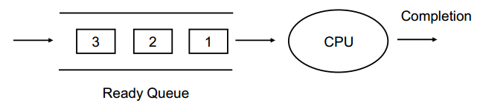
First-Come First-Served (FCFS) Scheduling
It is the simplest CPU scheduling algorithm.
The process that requests the CPU first is allocated the CPU first.
The average waiting time under FCFS is long.

Slide 32
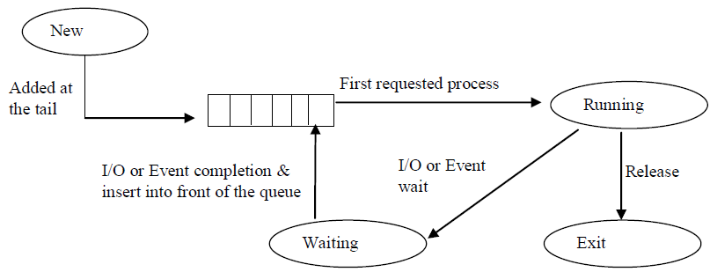
First-Come First-Served (FCFS) Scheduling
Figure shows First Come First Serve Scheduling

Slide 33
Example:1
Process Burst Time (In ms)
P1 24
P2 3
P3 3
Suppose that the processes arrive in the order: P1, P2 and P3
The Gantt Chart for the schedule is:
Waiting time for P1 = 0ms, P2 = 24ms and P3 = 27ms
Average waiting time: (0 + 24 + 27)/3 = 17ms
Average Turnaround Time (ATAT) = 24+27+30/3= 27ms
P₁
P₂
P₃
0
24
27
30

Slide 34
Example:2
Suppose that the processes arrive in the order: P2, P3 and P1
Waiting time for: P1 = 6ms, P2 = 0ms and P3 = 3ms
Average waiting time: (0 + 3 + 6)/3 = 3ms
Average Turnaround Time (ATAT)= 3+6+30/3=13ms
Much better than previous case.
The order of processes in FCFS queue is important.
P₂
P₃
P₁
0
3
6
30

Slide 35
Exercise 1
Consider the following processes: P1, P2 & P3 with their CPU burst time as shown below
Draw the Gantt chart
Waiting time for each process (WT)
Average Waiting time (AWT)
Average Turnaround Time (ATAT)
Process | CPU Burst time (ms)
P1 | 7
P2 | 8
P3 | 5

Slide 36
Advantages & Disadvantages of FCFS
Advantage
Simple and easy algorithm to implement
It is suitable for batch system
Disadvantage
The average waiting time is not minimal
It is not suitable for time sharing system

Slide 37
Shortest-Job-First (SJF) Scheduling
Also known as shortest job next.
The basic principle of this algorithm is to allocate the CPU to the process with least CPU burst time.
Associate each process with the length of its next CPU burst.
Use these lengths to schedule the process with the shortest time.
Best approach to minimize waiting time.
Easy to implement in Batch systems where required CPU time is known in advance.
Impossible to implement in interactive systems where required CPU time is not known.
The processer should know in advance how much time process will take.

Slide 38
Shortest-Job-First (SJF) Scheduling
Two schemes:
Non-preemptive: Once CPU given to the process it can not be preempted until completes its CPU burst.
Preemptive: if a new process arrives with CPU burst length less than remaining time of current executing process, preempt.
This scheme is know as the Shortest-Remaining-Time-First (SRTF).
SJF is optimal: gives minimum average waiting time for a given set of processes.
If the two processes have same CPU burst time the FCFS is used to break the tie.

Slide 39
Example of Non-Preemptive SJF
Draw Gantt chart for the above process?
Waiting time for each process?
Average waiting time?
Process ID | Arrival Time | Burst Time
P1 | 0 | 7
P2 | 2 | 4
P3 | 4 | 1
P4 | 5 | 4

Slide 40
Example of Non-Preemptive SJF
Solution
Gantt chart
Waiting time for each process
Waiting time= total waiting time-arrival time
waiting time: P1=0ms, P2=6ms, P3=3ms & P4=7ms
Average waiting time
(0 + 6 + 3 + 7) / 4 = 4ms
P₁
P₃
P₂
P₄
0
7
8
12
16

Slide 41
Example of Non-Preemptive SJF
If we used FCFS, then the average waiting time would be:
(0 + 5 + 7 + 7) / 4 = 4.75
The SJF gives less average waiting time than FCFS.
The SJF is a non-preemptive in which the waiting process with the smallest estimated run-time-to completion is run next.
Both FCFS and SJF are not useful for timesharing environments, because they are non-preemptive.

Slide 42
Example 1 of Preemptive SJF
SJF (preemptive) [Shortest-Remaining-Time-First (SRTF)]
Waiting time for each process?
Average waiting time?
Process ID | Arrival Time | Burst Time
P1 | 0 | 7
P2 | 2 | 4
P3 | 4 | 1
P4 | 5 | 4
P₁
P₂
P₃
P₂
P₄
P₁
0
2
4
5
7
11
16

Slide 43
Example 1 of Preemptive SJF
Solution
Waiting time for each process = total waiting time - number of millisecond process executed - arrival time.
P1= 11 – 2 – 0 = 9ms
P2= 5 – 2 – 2 = 1ms
P3= 4 – 0 – 4 = 0ms
P4= 7 – 0 – 5 = 2ms
Average waiting time = (9 + 1 + 0 +2) / 4 = 3ms

Slide 44
Example 2 of Preemptive SJF
Gantt chart?
Waiting time?
Average waiting time?
Process ID | Arrival Time | Burst Time
P1 | 0 | 12
P2 | 2 | 4
P3 | 3 | 6
P4 | 8 | 5

Slide 45
Example 2 of Preemptive SJF
Solution
Gantt chart of the above process
Waiting time for each process
P1 = 17 – 2 – 0 = 15ms
P2 = 2 – 0 – 2 = 0ms
P3 = 6 – 0 – 3 = 3ms
P4 = 12 – 0 – 8 = 4ms
Average waiting time = (15 + 0 + 3 + 4)/4= 5.5ms
P1 | P2 | P3 | P4 | P1
0 | 2 | 6 | 12 | 17 27

Slide 46
Exercise 2
Consider the following set of processes having their CPU-burst time and arrival time. Based on these find the average waiting time using
Non- preemptive SJF?
Preemptive SJF?
Process ID | Arrival Time | Burst Time
P1 | 0 | 3
P2 | 2 | 6
P3 | 4 | 4
P4 | 6 | 5
P5 | 8 | 2

Slide 47
Priority Scheduling
A priority number (integer) is associated with each process, and the CPU is allocated to the process with the highest priority.
Priority may be determined by users or by some default mechanism.
The system may determine the priority based on:
Memory requirements,
Time limits, or
Other resource usage.
The CPU is allocated to the process with the highest priority
(smallest integer = highest priority).
Equal priority processes are scheduled in FCFS order.

Slide 48
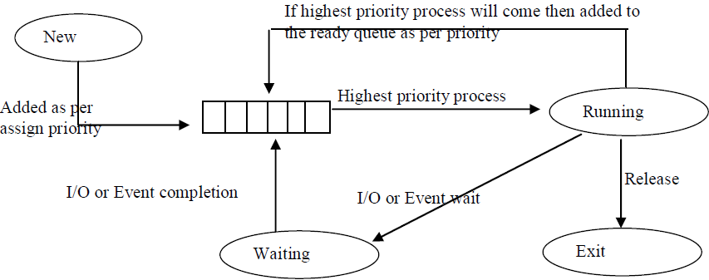
Priority Scheduling
Figure: Priority Scheduling

Slide 49
Priority Scheduling
Priorities can be defined either internally or externally.
Internally priority:- use of some measurable quantity or quantities to compute the priority of a process.
For example,
Memory requirements,
Number of open files,
Ratio of average I/O burst to average CPU burst have been used in computing priorities.
Externally priority:- is set by criteria that is external to the O.S.
Such as importance of the process.

Slide 50
Priority Scheduling
SJF is a special case of general priority scheduling, where as priority is the predicted next CPU burst time.
Priority can be either preemptive or non-preemptive.
A preemptive: priority will preempt the CPU if the newly arrived process is higher than the priority of the currently running process.
A non-preemptive: priority will simply put the new highest priority process at the head of the ready queue.

Slide 51
Problem with priority scheduling
A major problem with priority scheduling is indefinite blocking or Starvation (waiting for the CPU but never gets the CPU)
A process that is ready to run but waiting for the CPU can be considered blocked.
A priority scheduling algorithm can leave some low priority processes waiting indefinitely.
In a heavily loaded computer system, a steady stream of higher-priority processes can prevent a low- priority process from ever getting the CPU.

Slide 52
Solution to the problem
A solution to the problem of indefinite blockage of low-priority processes is aging.
Aging is a technique of gradually increasing the priority of processes that wait in the system for a long time.
For example:
If priorities range from 1279 (low) to 0 (high), we could increase the priority of a waiting process by 1 every 15 minutes.
Eventually, even a process with an initial priority of 127 would have the highest priority in the system and would be executed.

Slide 53
Example (preemptive base)
Consider a set of three processes P1, P2 & P3 with their priorities and arrival times.
1= highest priority, 3= least priority
AWT = (8 - 1) + (4 - 2) + 0/3
= 7 + 2 + 0/3 = 9/3 = 3ms
Process | Burst Time | Priority | Arrival Time
P1 | 10 | 3 | 0
P2 | 5 | 2 | 1
P3 | 2 | 1 | 2
P₁
P₂
P₃
P₂
P₁
0
1
2
4
8
17

Slide 54
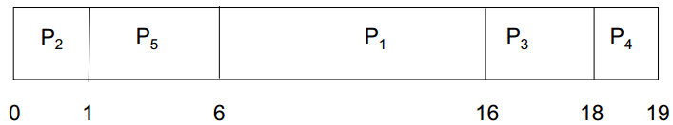
Example (Non-preemptive)
Priority scheduling Gantt Chart
Average waiting time?
Process | Burst Time | Priority
P1 | 10 | 3
P2 | 1 | 1
P3 | 2 | 4
P4 | 1 | 5
P5 | 5 | 2

Slide 55
Example (Non-preemptive)
Solution
Waiting time = total waiting time - number of processes execution in milliseconds - arrival time
Waiting time
P1 = 6,
P2 = 0,
P3 = 16,
P4 = 18 and
P5 = 1
Average waiting time = 8.2ms

Slide 56
Exercise 2:
Consider the set of process with arrival time(in milliseconds), CPU burst time (in milliseconds) and priority( 0 is the highest priority) shown below. None of the processes have I/O burst time.
The average waiting time(in milliseconds)of all the processes using preemptive priority scheduling algorithm is _____?
Process Id | Arrival time | Burst time | Priority
P1 | 0 | 11 | 2
P2 | 5 | 28 | 0
P3 | 12 | 2 | 3
P4 | 2 | 10 | 1
P5 | 9 | 16 | 4

Slide 57
Exercise 2:
Solution
Gantt chart
Priority for each process:
Waiting time = total waiting time - number of processes execution in milliseconds - arrival time
P1 = 40 – 2 – 0 = 38
P2 = 5 – 0 – 5 = 0
P3 = 49 – 0 – 12 = 37
P4 = 33 – 3 – 2 = 28
P5 = 51 – 0 – 9 = 42
Average WT = (38 + 0 + 37 + 28 + 42)/5 = 29
P1 | P4 | P2 | P4 | P1 | P3 | P5
0 2 | 2 5 | 5 33 | 33 40 | 40 49 | 49 51 | 51 67

Slide 58
Round Robin (RR) Scheduling
The Round Robin is designed for time sharing systems.
The RR is similar to FCFS, but preemption is added to switch between processes.
Each process gets a small unit of CPU time (time quantum or time slice ) usually 10-100milliseconds.
After this time has elapsed, the process is preempted and added to the end of the ready queue.
That is, after the time slice is expired an interrupt will occur and a context switch.

Slide 59
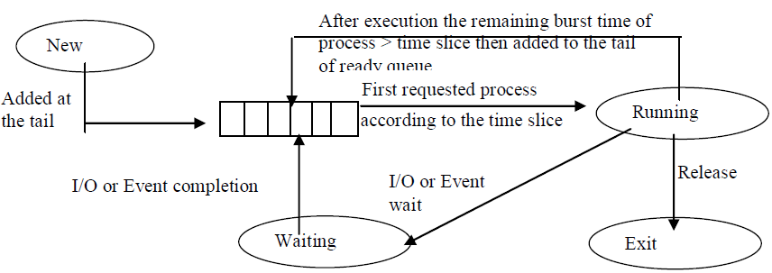
Round Robin (RR) Scheduling
Figure: Round Robin Scheduling

Slide 60
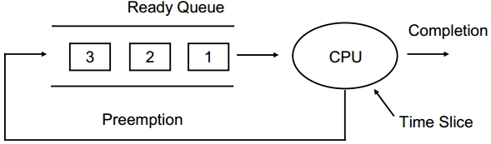
Round Robin (RR) Scheduling
If there are n processes in the ready queue and the time quantum is q, then each process gets 1/n of the CPU time in chunks of at most q time units at once.
No process waits more than (n-1)q time units.

Slide 61
Round Robin (RR) Scheduling
The performance of RR depends on the size of the time slice q:
If q very large (infinite) ⇒ FCFS
If q very small ⇒ RR is called processor sharing, and context switch increases.
So, q must be large with respect to context switch, otherwise overhead is too high.

Slide 62

Example: RR with Time Quantum = 20
The Gantt chart is:
Average Waiting Time = (81 + 20 + 94 + 97) / 4 = 73ms
Process ID | Burst Time | Waiting Time of each process
P1 | 53 | 0 + (77 - 20) + (121 - 97) = 81
P2 | 17 | 20
P3 | 68 | 37 + (97 - 57) + (134 - 117) = 94
P4 | 24 | 57 + (117 - 77) = 97

Slide 63
Exercise 2:
Consider the set of 5 processes whose arrival time and burst time are given below:
If the CPU scheduling policy is round robin with the time quantum= 2 units, calculate the average waiting time and average turnaround time.
Process ID | Arrival Time | Burst Time
P1 | 0 | 5
P2 | 1 | 3
P3 | 2 | 1
P4 | 3 | 2
P5 | 4 | 3

Slide 64
Exercise 2:
Solution
Gantt chart:
P1 | P2 | P3 | P1 | P4 | P5 | P2 | P1 | P5
0 | 2 4 | 5 | 7 | 9 | 11 | 12 | 13 | 14
Ready Queue | Arrival Time |  |  | Time(Clock)
 |  |  | P2 | 1
 |  | P1 | P3 | 2
 | P4 | P1 | P3 | 3
P2 | P5 | P4 | P1 | 4
 | P2 | P5 | P4 | 5
 | P1 | P2 | P5 | 7
 |  | … | … | …
 |  | P5 | P1 | 12
 |  | … | … | …

Slide 65
Exercise 2:
Solution
Turn Around Time = Completion Time – Arrival Time
Waiting time = Turn Around time – Burst Time
Process ID | Completion Time | Turn Around Time | Waiting Time
P1 | 13 | 13 – 0 = 13 | 13 – 5 = 8
P2 | 12 | 12 – 1 = 12 | 11 – 3 = 8
P3 | 5 | 5 – 2 = 3 | 3 – 1 = 2
P4 | 9 | 9 – 3 = 6 | 6 – 2 = 4
P5 | 14 | 14 – 4 = 10 | 10 – 3 = 7

Slide 66
Exercise 2:
Solution
Average Turn Around Time = Completion Time – Arrival Time / n = (13 + 11 + 3 + 6 + 10) / 5 = 43 / 5 = 8.6 units
Average Waiting time = Turn Around time – Burst Time / n = (8 + 8 + 2 + 4 + 7) / 5 = 5.8 units

Slide 67
Multi level Queue Scheduling
Ready queue is partitioned into separate queues:
Foreground (interactive)
Background (batch)
Each queue has its own scheduling algorithm:
Foreground – RR
Background – FCFS
Scheduling must be done between the queues.

Slide 68
Multi level Queue Scheduling
Fixed priority scheduling; i.e., serve all from foreground then from background.
Possibility of starvation.
Time slice – each queue gets a certain amount of CPU time which it can schedule amongst its processes:
80% to foreground in RR
20% to background in FCFS

Slide 69
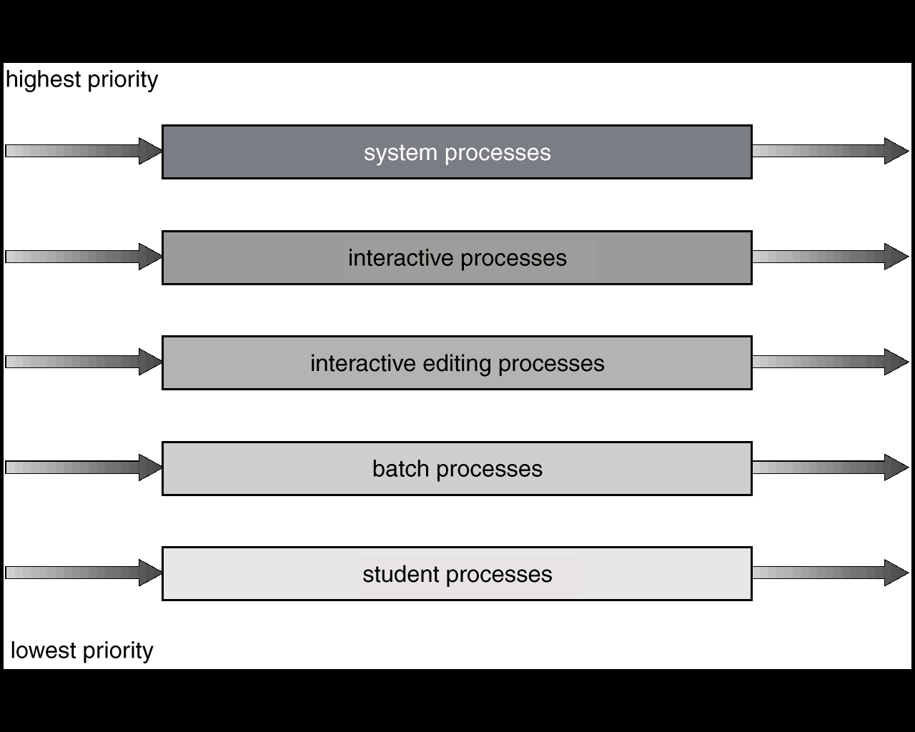
Multi level Queue Scheduling

Slide 70
Multilevel Feedback Queue
Different from Multilevel Queue Scheduling by Allowing Processes to Migrate among queues.
A process can move between various queues, aging can be implemented this way.
If a process waits too long in a lower-priority queue may be moved to a higher-priority queue (this form of aging to prevent starvation).
If a process uses too much CPU time, it will be moved to lower-priority queues.
This leaves I/O bound and interactive processes in the higher-priority queues.
In general, the multilevel feedback queue scheduling algorithm is the most complex.

Slide 71
Example: Multilevel Feedback Queue
Three queues:
Q0 – Time quantum 8 milliseconds
Q1 – Time quantum 16 milliseconds
Q2 – FCFS
Scheduling:
A new job enters queue Q0 which is served FCFS. When it gains CPU, job receives 8milliseconds. If it does not finish in 8 milliseconds, job is moved to queue Q1
At Q1 job is again served FCFS and receives 16 additional milliseconds.
If it still does not complete, it is preempted and moved to queue Q2.
The Multilevel Feedback Queue Scheduling is preemptive.

Slide 72
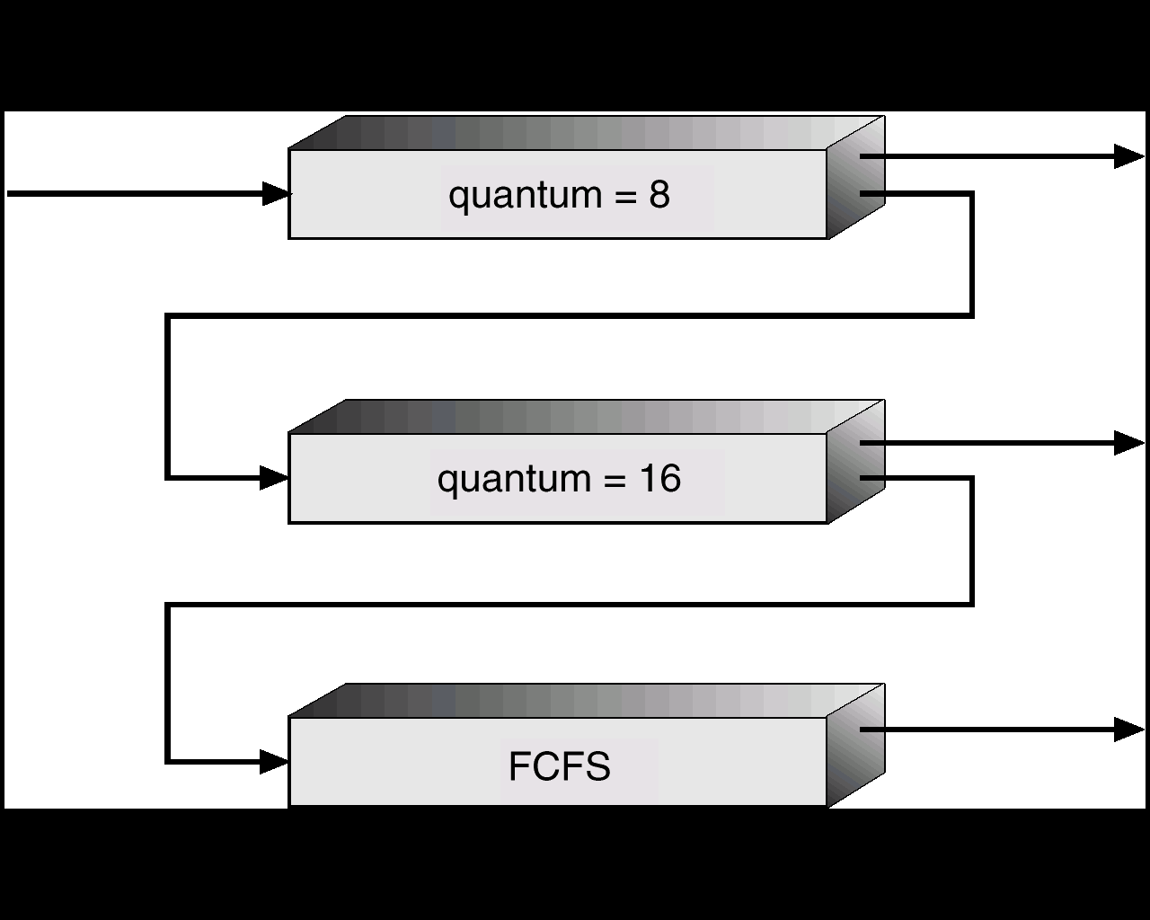
Multilevel Feedback Queue

